Slide 2
Contents
PART 1 Product advantages
PART 2 Application scenarios
PART 3 Product parameters
PART 4 Product pictures

Slide 3
PART 1. Super Hit Master
Product advantages

Slide 4
Intelligent IC-Chip massage gun
More comfortable and safer to use
5 Technologies Really Intelligent & Impressively user-friendly
◎The body has a built-in SuperHit intelligent control chip,
which is different from traditional or "pseudo-intelligent" fascia guns.
Behind the intelligent technology of SuperHit's sophisticated algorithm
is more attentive user care!
◎ Super Hit won the IF Award, known as the "Oscar" in industrial design

Slide 5
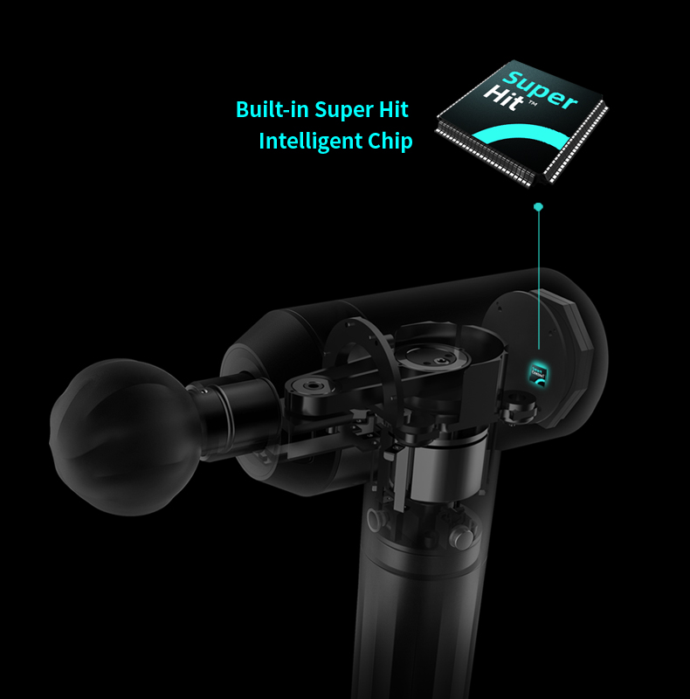
Exclusive Product Advantages
◎ AI Intelligent muscles and bones recognition.
◎ AI Auto-adaptive percussion modes switching
◎ AI Visual intelligent controll interface.
◎ AI Intelligent idling technology for power saving.
◎ AI Intelligent voice broadcast systemt.
◎ Aircraft-grade PEEK material, more resistant to high temperature, wear and damage, and deformation.
◎ Longer handle design to better percussion back area. Handle made of with food-grade level silicone material and covering with nice coating.
◎ Five types of redesigned massage heads: We start from the pain points of the sports crowd, gain in-depth insight into the real needs of different exercise intensities, and deeply improve and redefine the material, hardness, strength, shape, texture and percussion method.

Slide 6
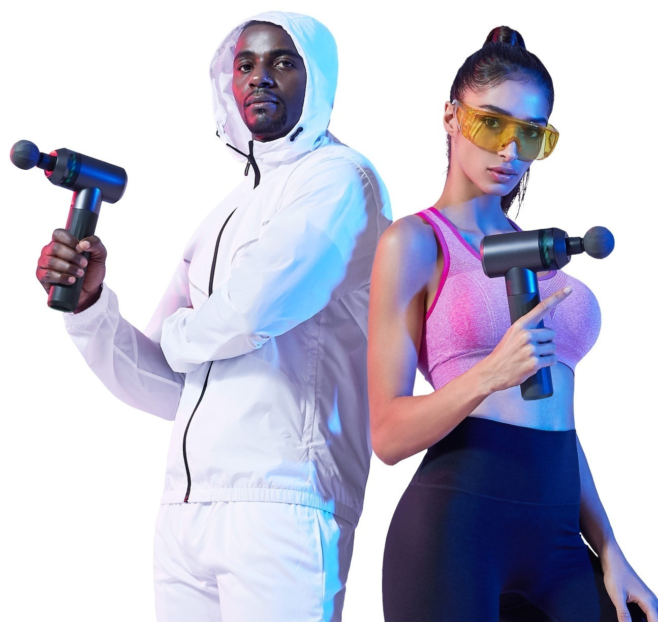
Product Functions
◎ Warm-up activation before exercise, improve the explosive power and expressive power of muscle groups, and prevent muscle damage.
◎ Muscle fascia relaxes after exercise, discharges lactic acid, relieves soreness and pain, and prevents delayed onset muscle soreness.
◎ Relieve shoulder and neck discomfort, backache and leg pain of office workers and occupational workers who sit for a long time and stand for a long time, and prevent occupational diseases.
◎ Dissolve fascial nodules, improve adhesion, and prevent pain and tenderness caused by nodular fasciitis.
◎Avoid hitting injuries during use (AI Intelligent muscles and bones recognition).
◎ Less difficult to use, quicker to get started and shorter learning costs （AI Voice broadcast+AI Intelligent control Interface+ AI Auto-adaptive percussion modes switching）

Slide 7
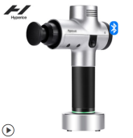
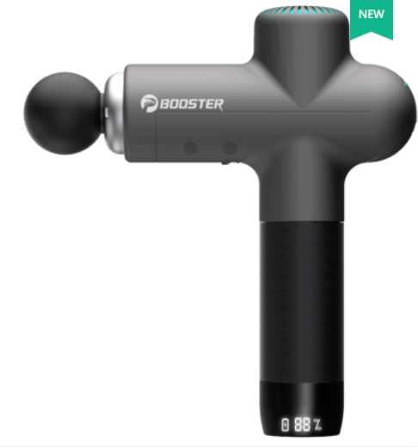
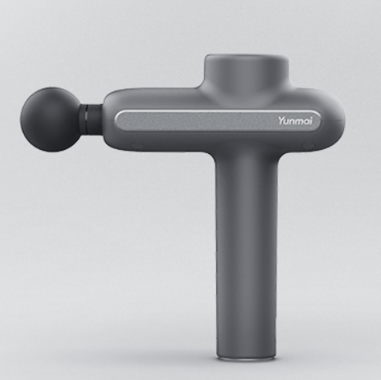
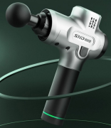
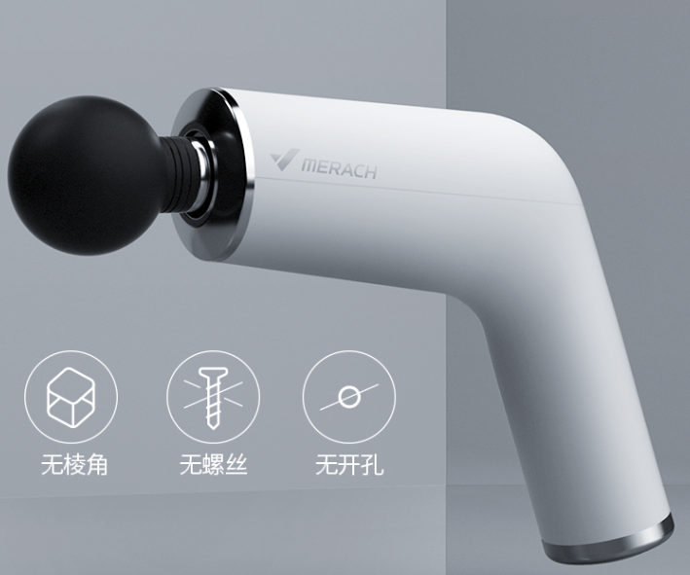
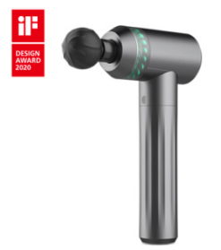
Massage Gun Comparison | Product | Main function | Difference | Massage head material | Market positioning | Retail/E-commerce Price
Hypervolt hyperice |  | break down lactic acid percussion deeply to fascia muscle relaxation, pain relief activation and strengthening | Bluetooth connection APP custom muscle care Pressure sensing technology to intelligently adjust the strength Quiet well-known products | ABS material | high-end | USD430
BOOSTER |  | break down lactic acid percussion deeply to fascia muscle relaxation, pain relief activation and strengthening | Athlete endorsement Rehabilitation Hospital Professor Endorsement Vector Strike Control Technology Intelligent adjustment of hitting strength | ABS material | mid-end | USD85
YUNMAI |  | break down lactic acid percussion deeply to fascia muscle relaxation, pain relief activation and strengthening | Red Dot Award football player endorsement Vector Strike Control Technology Intelligent adjustment of hitting strength | ABS material | mid-end | USD150
SND |  | break down lactic acid percussion deeply to fascia muscle relaxation, pain relief activation and strengthening | Feels more substantial More suitable for professionals | ABS material | mid-end | USD75
MERACH |  | break down lactic acid percussion deeply to fascia muscle relaxation, pain relief activation and strengthening | Unique appearance design Magnetic charging | ABS material foam head | mid-end | USD80
Fittop |  | break down lactic acid percussion deeply to fascia muscle relaxation, pain relief activation and strengthening | Voice broadcast Intelligent chip control Automatic bone recognition Idling systems for power saving switching massage head detection | Food grade silicone massage head Honeycomb structure in massage head Elastic touch Patented Capsule Joint Massage Head Patented Achilles Massage Head | high-end | USD480

Slide 8
Fittop Super Hit Master Competitve Advantages
As analyzed in the figure, Fittop massage gun has intelligent design that is more suitable for new users, as well as the core massage comfort and strike feelings.

Slide 9
Super Hit Master- Advantage 1
AI Intelligent bone and muscle recognition
The body structure contains a variety of rich tissues
such as fascia, muscles, bones, blood vessels, etc.
Therefore, when relieving muscle soreness,
you must not treat them roughly.
SuperHit Master is equipped with an intelligent control chip, which can intelligently identify and protect the muscles and bones. Once the bones are hit by mistake, the system will immediately reduce the frequency and power to protect the bones from accidental damage, provides you a more comfortable and safer experience.

Slide 10
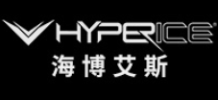
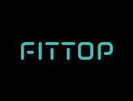
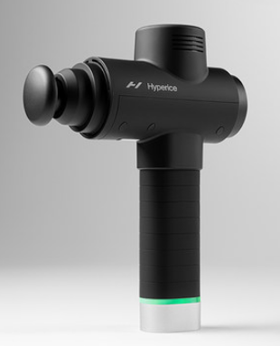
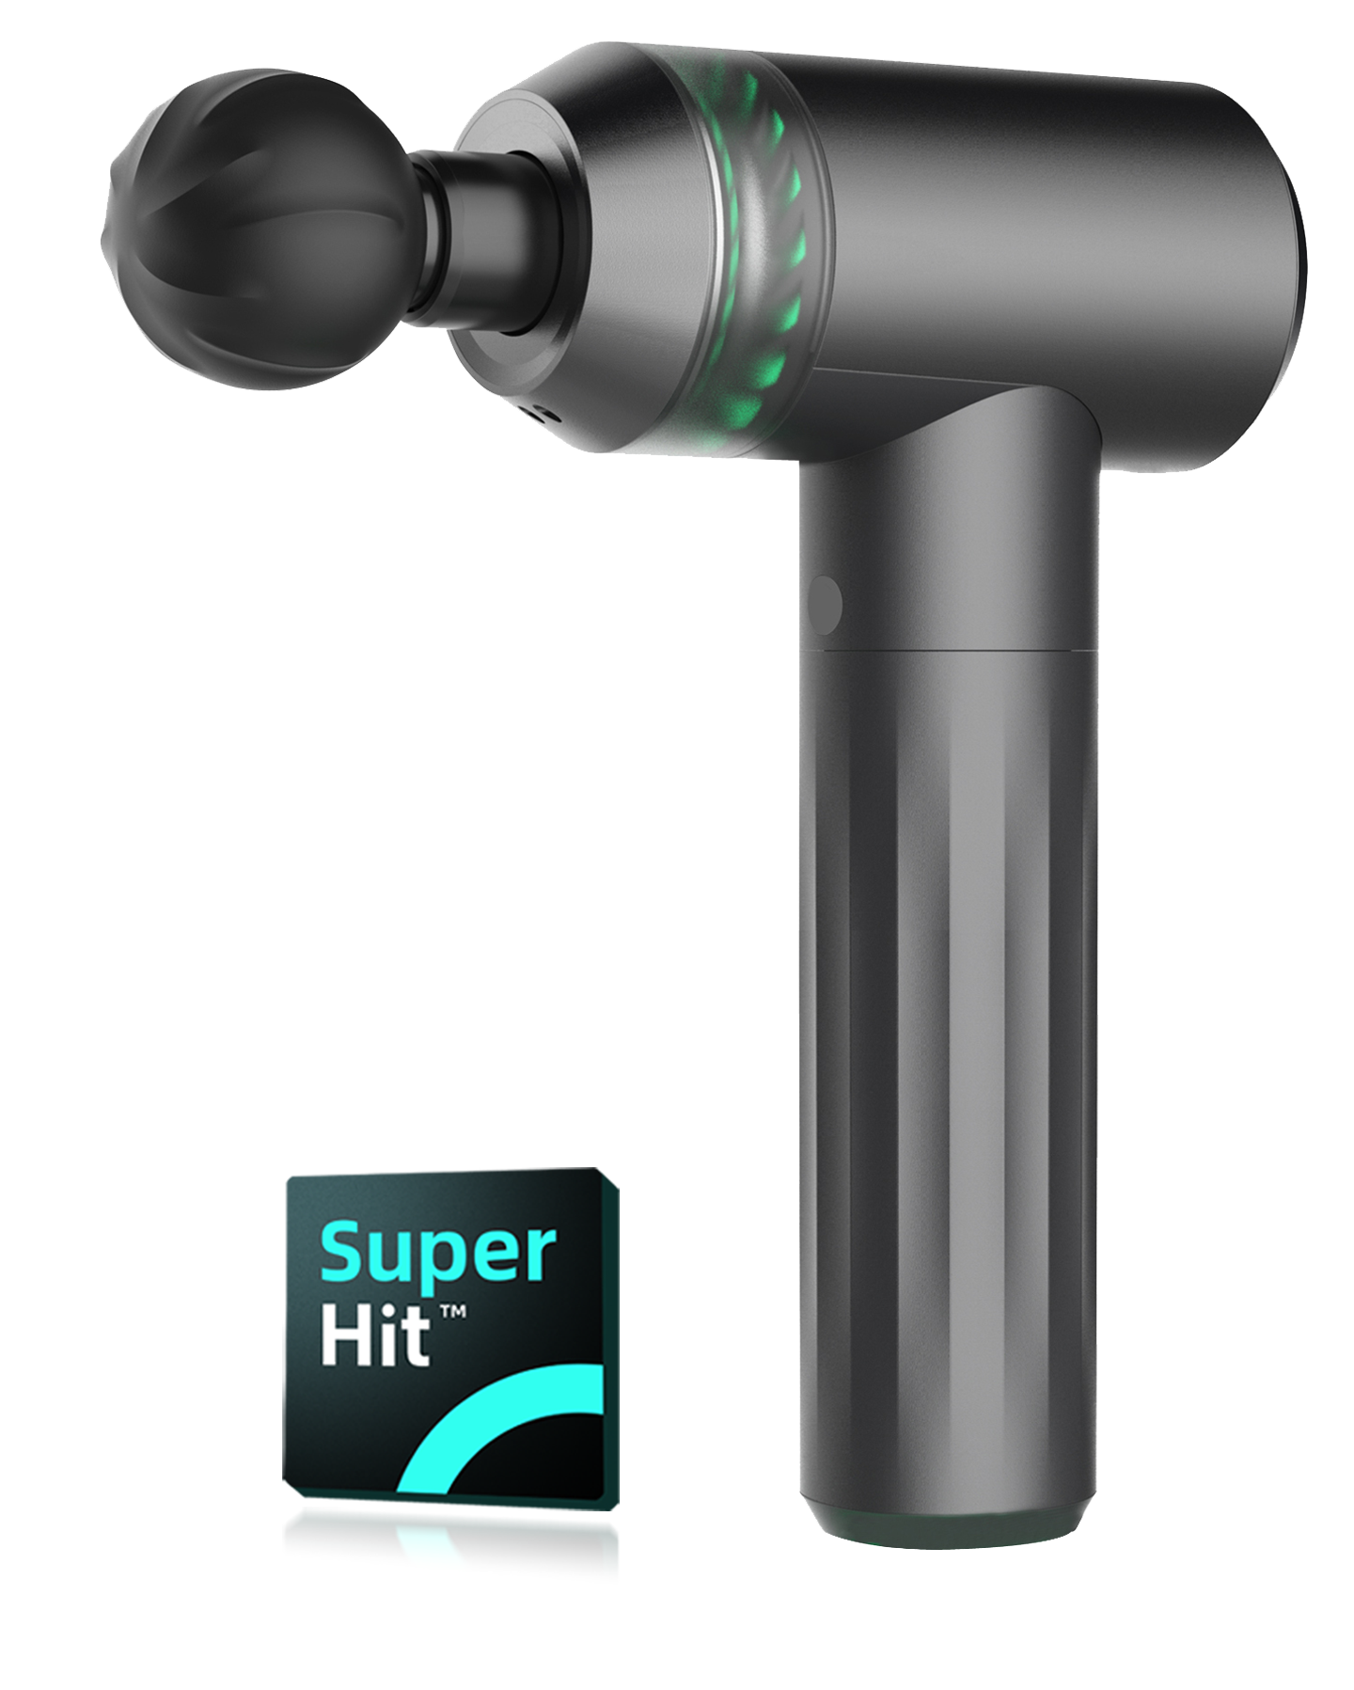
Comparsion
No automatic identification function.
Intelligent bone recognition
Not afraid of accidental injury, safe to us.

Slide 11
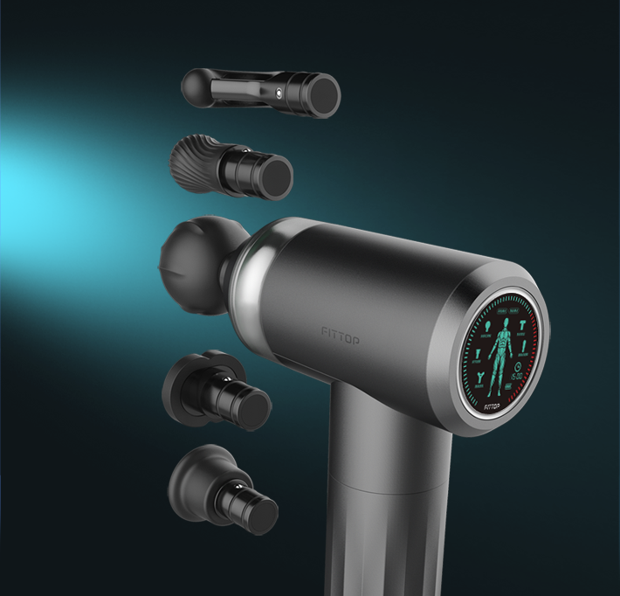
Super Hit Master- Advantage 2
AI Auto-adaptive percussion modes switching
When inserting different massage head, the system will automatically identify, at the same time automatically configure the massage head corresponding to the percussion mode, intensity, amplitude.
Precise configuration of percussion for different muscle areas.

Slide 12
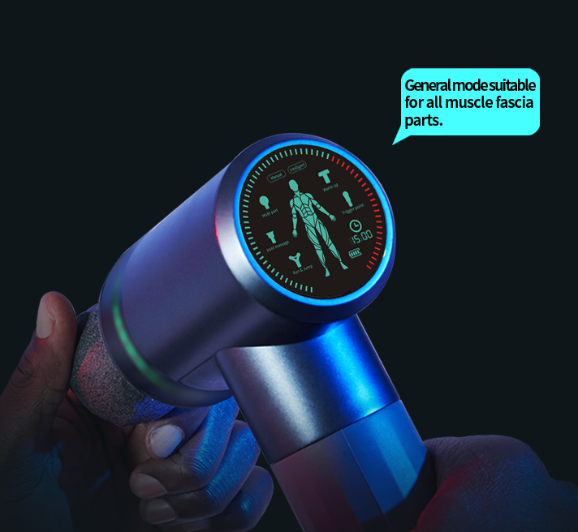
Super Hit Master- Advantage 3
AI Voice broadcast
Unlike the traditional massage guns without intelligent voice broadcast, Super Hit Master provides more convenient and instant voice guidance. When inserting different massage head, the system will automatically switch percussion mode,At the same time automatically voice broadcasting.

Slide 13
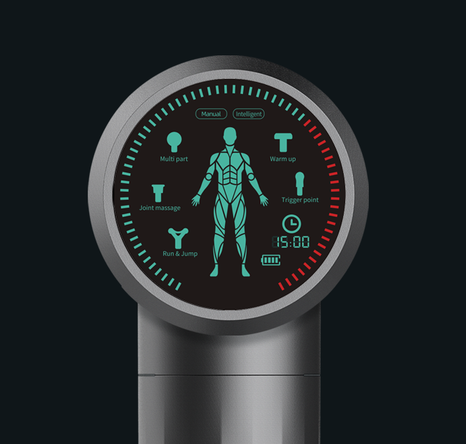
Super Hit Master- Advantage 4
AI Visual intelligent control
interface
Super Hit Master has more intelligent control interface for higher Interactivity level,minimize users' learning costs, shorten interactive paths.
Percussion modes, massage head icons, massage areas, time countdown, battery reminder, etc, all clear at a glance. Whether you are a professional or green hand, you can quickly master it!

Slide 14
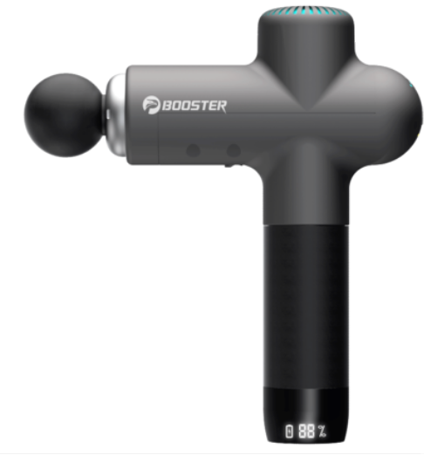
Comparsion
Without voice and visual functions, it is difficult for new users to get started and requires professional guidance.
Voice broadcast and visual interface, intelligent, to shorten time to learn how to use it.

Slide 15
Super Hit Master- Advantage 5
AI Intelligent idling technology
Different from the traditional massage gun , Super Hit master has the power saving technology to save power.
When the body is hovering or away from the body, it will automatically idle or rest, intelligent power saving, increase battery life, and can extend the service life of the product!

Slide 16
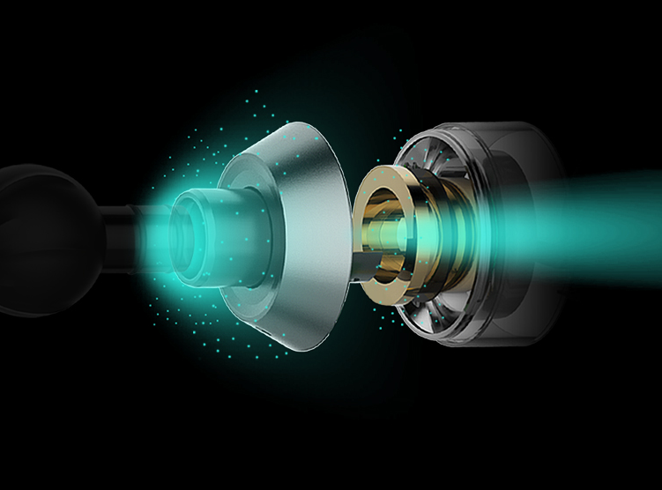
Super Hit Master- Advantage 6
Aircraft-grade PEEK material
Super Hit master uses special aircraft-grade PEEK material! Unique molecular structure and modification technology make core components more wear-resistant, lower noise, more resistant to high temperature, better deformation resistance, longer life.

Slide 17
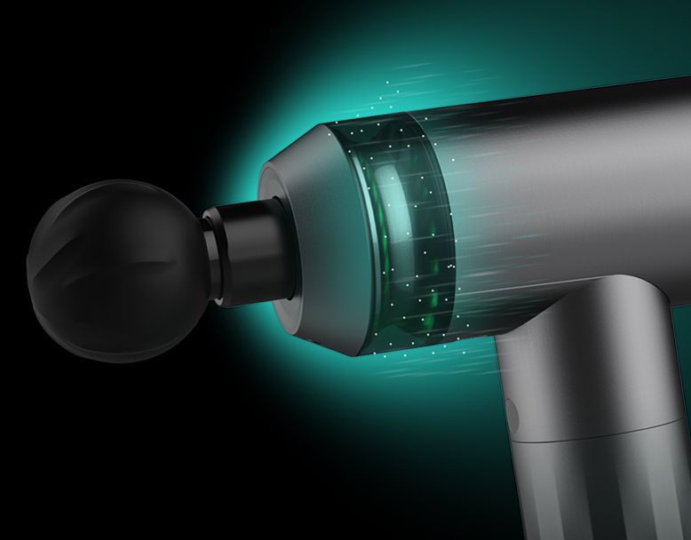
Super Hit Master- Advantage 7
Cool Light Decoration
The cool light decoration design creates an atmosphere full of dynamic energy that makes exercise more enjoyable.

Slide 18
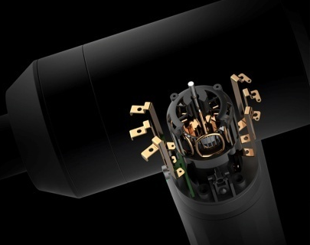
Super Hit chip level massage gun (master)-advantage 8
Super Hit Master- Advantage 8
Super Hit 芯片级
筋膜枪（尊享版）- 优势 8
High torque brushless motor
Unlike the usual massage gun,
Super Hit Master uses high torque brushless motor
and the start power up to 853mN.m.
Powerful purcussion into deep muscle fascia.
Deep relaxation, strong power,
and pleasurable massager!

Slide 19
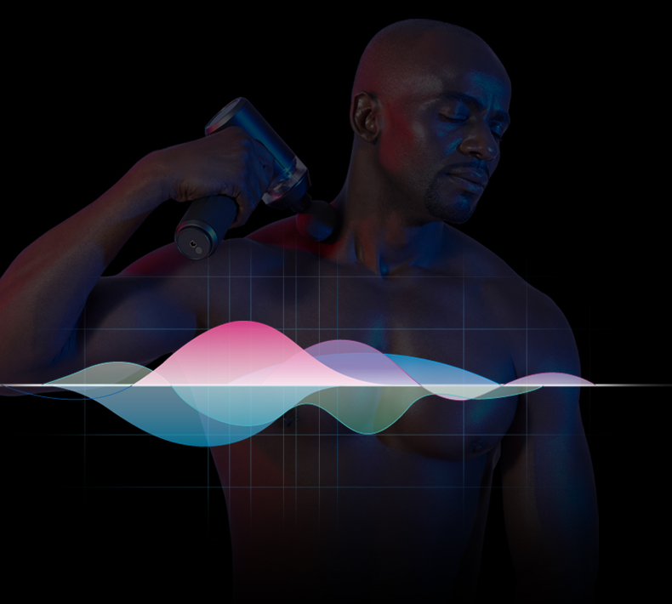
Super Hit chip level massage gun (master)-advantage 9
Super Hit Master- Advantage 9
Quiet Percussion and
Low Noise
Super Hit Master offers you quiet massage
without disturbing others
and makes you enjoy the relaxation moment.

Slide 20
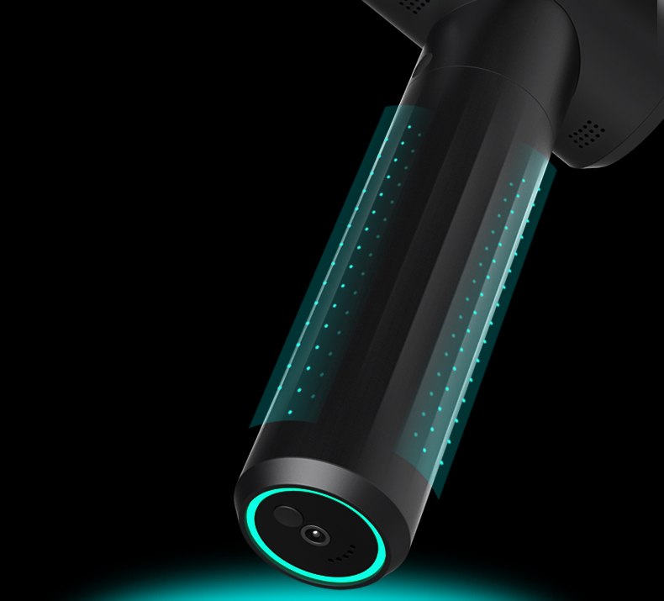
Super Hit Master- Advantage 10
Silicone handle to anti-slip and anti-sweat
Different from the traditional massage gun,
the silicone handle is soft, anti-sweat and anit-slip,
more comfortable holding makes you feel at ease. No worry about accidental slipping!

Slide 21
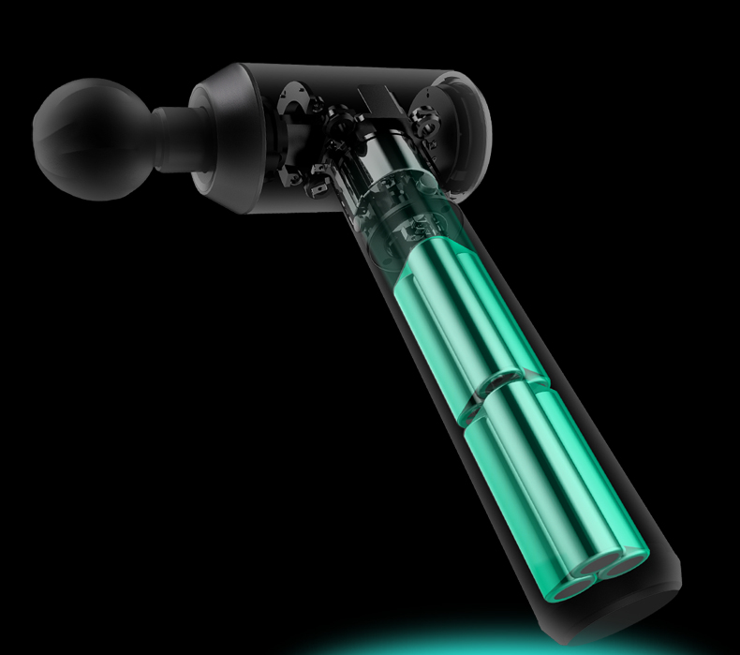
Super Hit Master- Advantage 11
Long Battery Life
Super Hit Master adopting lithium battery in sport car level, with longer battery duration,
charging one hour percussing for one month. No more troubling for frequent charging.

Slide 22
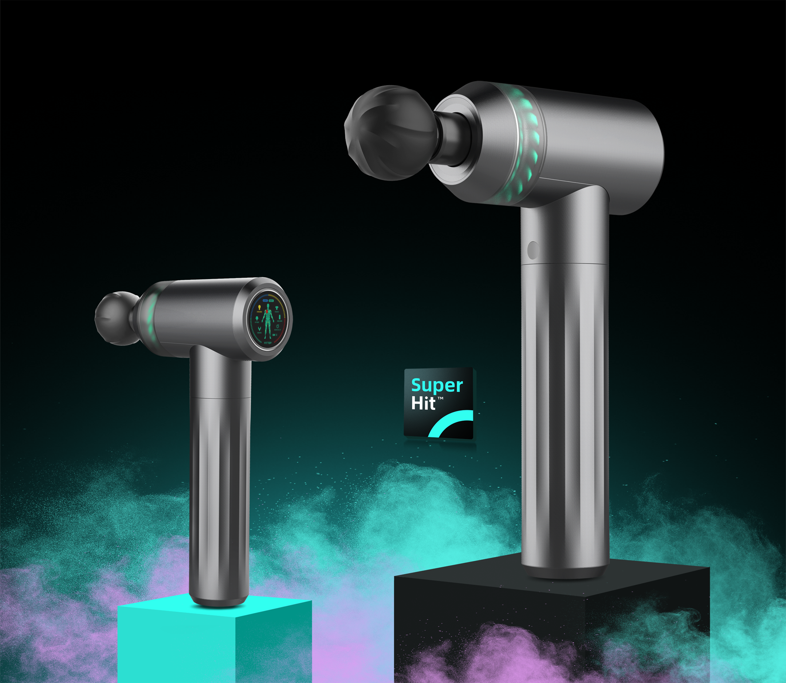
Advantages Summary
◎ Build-in Super Hit Intelligent chip
◎ AI Intelligent muscles and
bones recognition
◎ AI Auto-adaptive percussion
modes switching
◎ AI Voice broadcast
◎ AI Intelligent control Interface
◎ AI Intelligent Idling system
for power saving
◎ Aircraft-grade PEEK material
◎ Cool light decoration
◎ High torque brushless motor
◎ Quiet percussion
◎ Anti-sweat and anti-slip silicon handle
◎ Longer battery duration

Slide 23
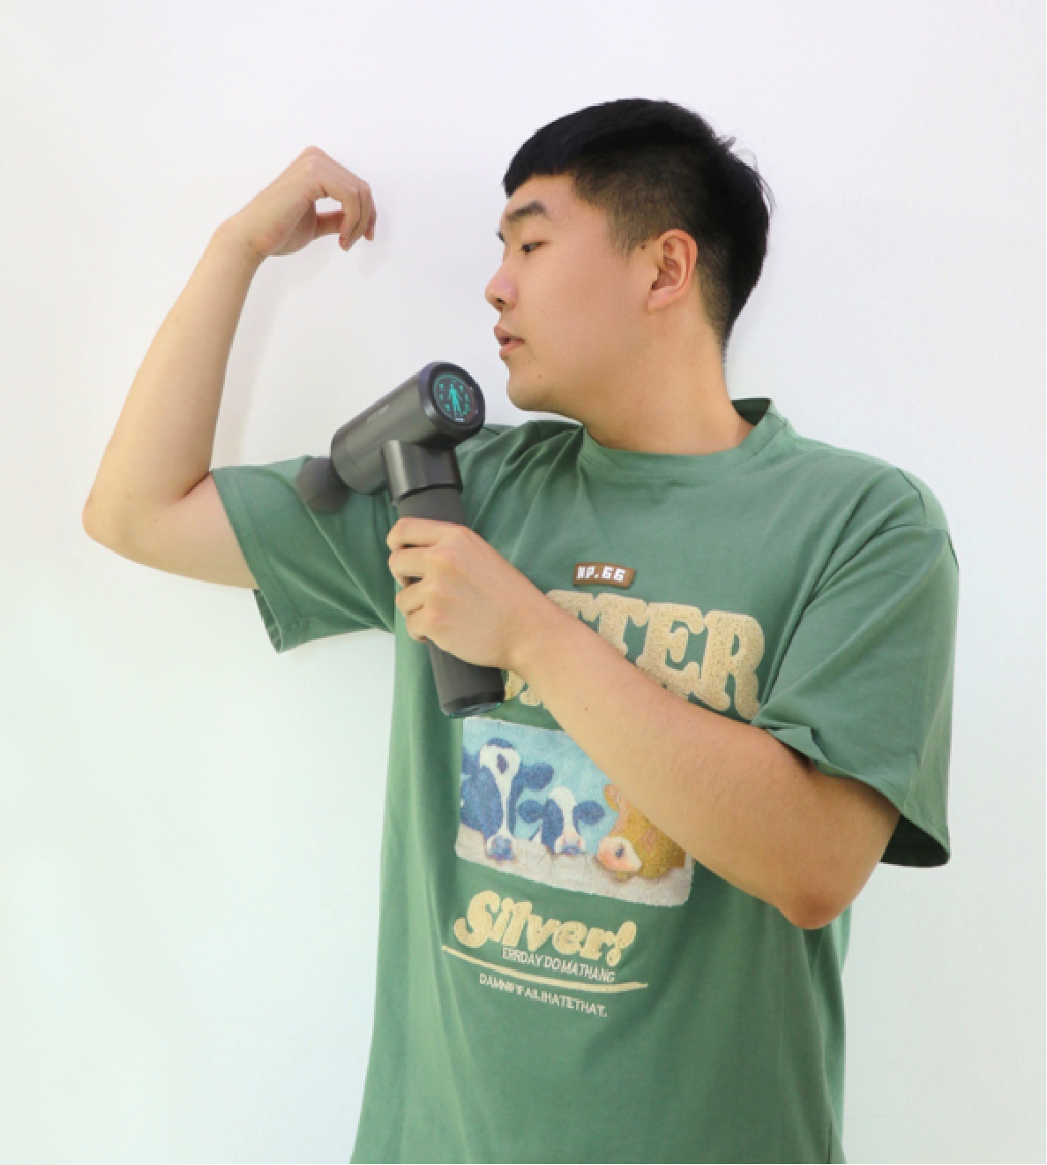
User experience feedback One
After trying many brands, I finally found Fittop Super-Hit massage gun. It opened the door to a new world for me after using it. I am a programmer, and I usually exercise after get off work.
The use experience is amazing for me.It’s very comfortable to hold it in hand. The hitting power is particularly deep and it is relatively friendly to newbies. It equited with very elegant storage box is more convenient to carry and store. Friends who often go to the gym can also take it with them.

Slide 24
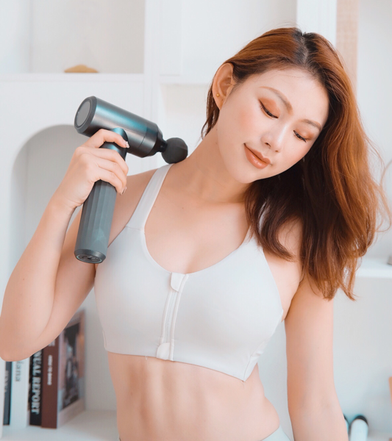
User experience feedback
At one chance, a fitness coach recommended me to use this Fittop massage gun. It has five different massage heads for each part.After exercise, I use the circular massage head to massage my calves.Not only can promote blood circulation well. At the same time, it can improve the muscles of the legs and eliminate the edema of the thighs.
Especially as I get older, I find that my shoulder and neck are not good, so I will use it to massage my shoulder and neck. It can open up the meridians well, and the massage strength can be adjusted. The design of the visual intelligent compass is very considerate.
It can be well relieved for soreness, pain and muscle soreness. Generally speaking, it is a high cost performance massage gun! The operation is very convenient. And it also comes with an Eva storage bag, which is very convenient to carry when going out. It is very suitable to put it in the gym cabinet.

Slide 25
PART 2. Super Hit Master
Application scenarios

Slide 26
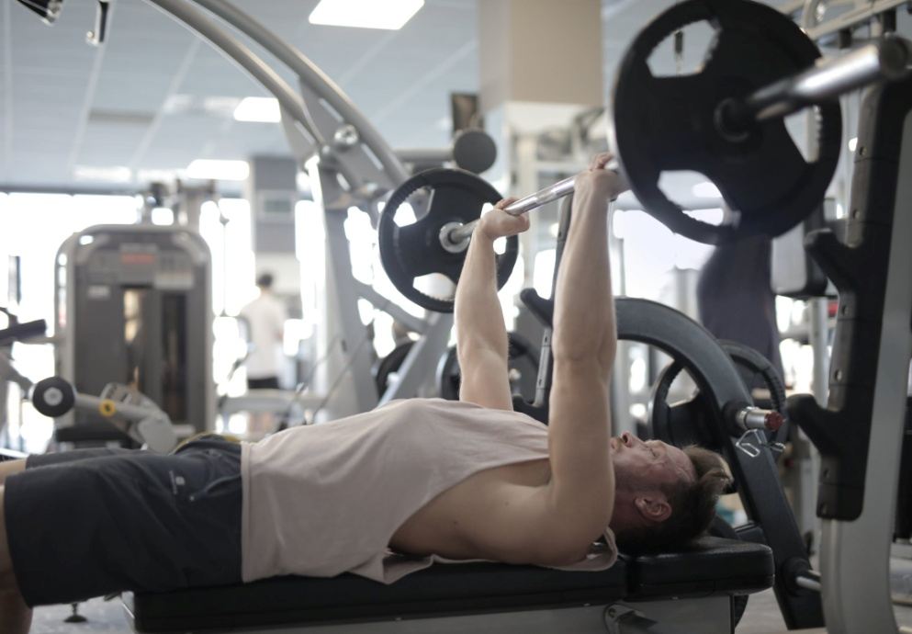
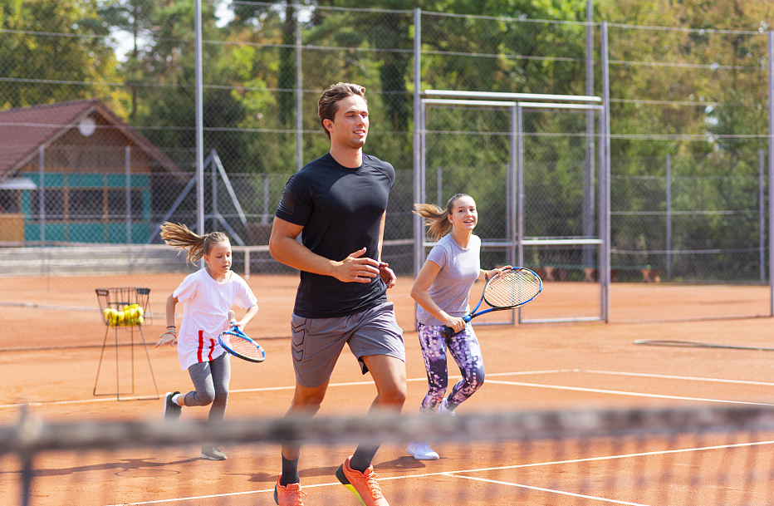
Application Scenes： Gyms, Playgrounds(ball games, execising),etc
Relieve muscle soreness after workout
Warm-up before exercise and muscle relaxation and soreness relief after exercise
Relax muscle after ball games to remove latic acid

Slide 27
PART 3. Super Hit Master
Product parameters

Slide 28
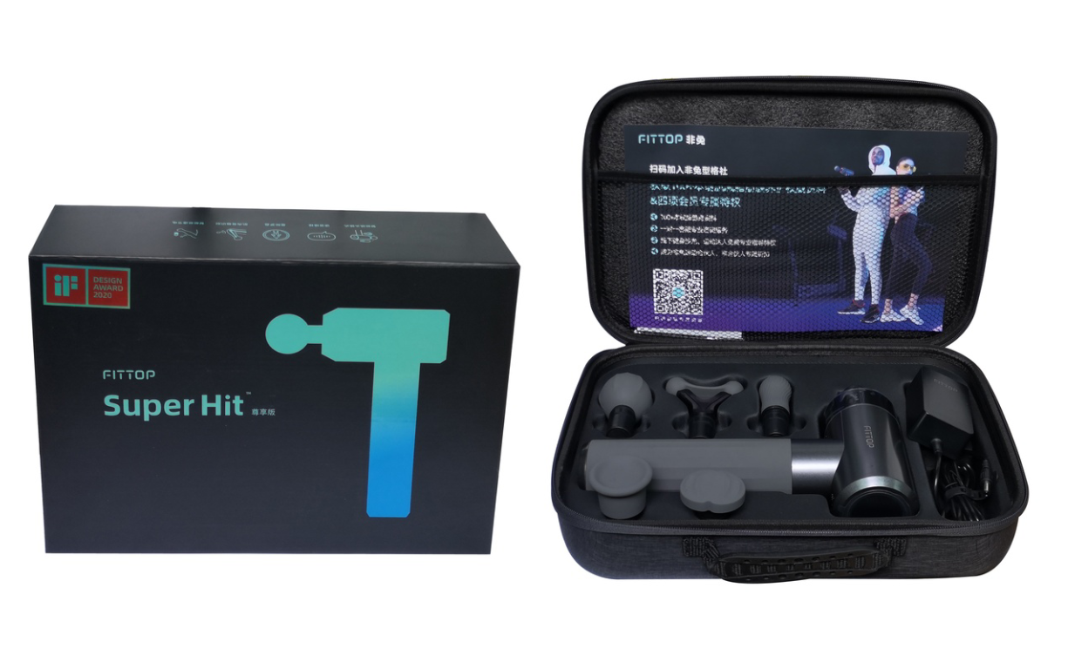
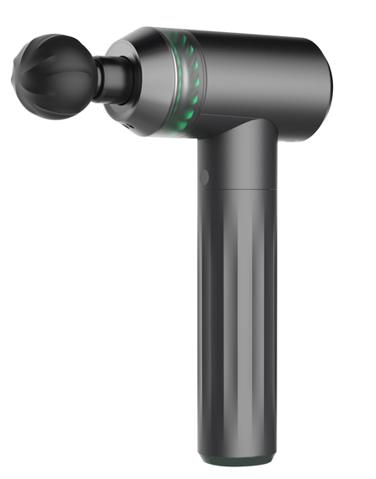
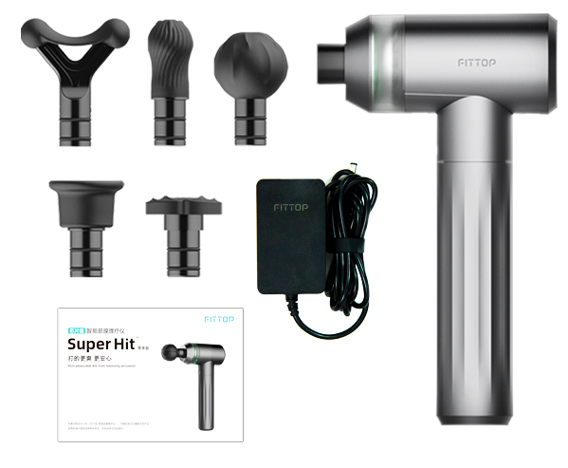
Parameters and Package
Product model：FSM31
Product size：148.5*63*253.5mm
Product weight：约0.9kg
Adaptor：DC,29V-1A
Rated current：1000mA
Rated power：29W
Charging hour：around 3.5H
Battery volume：2500mAh
Battery life: around 4.5hours(at highest speed）
Auto-timing: 15mins
Massage Heads: 5 professional massage heads
Mode: Intelligent mode and manual mode
Highest speed：3500rpm

Slide 29
PART 4. Super Hit Master
Product pictures

Slide 30
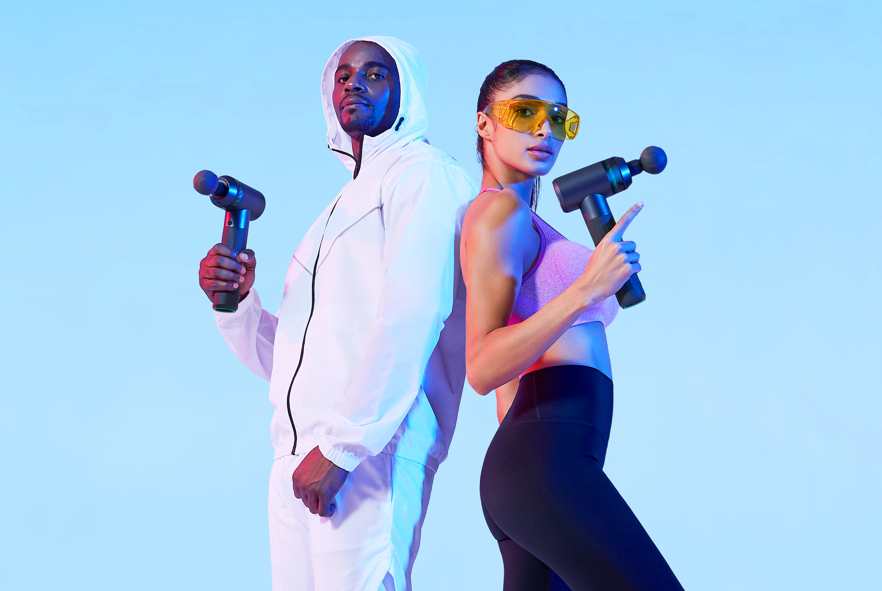
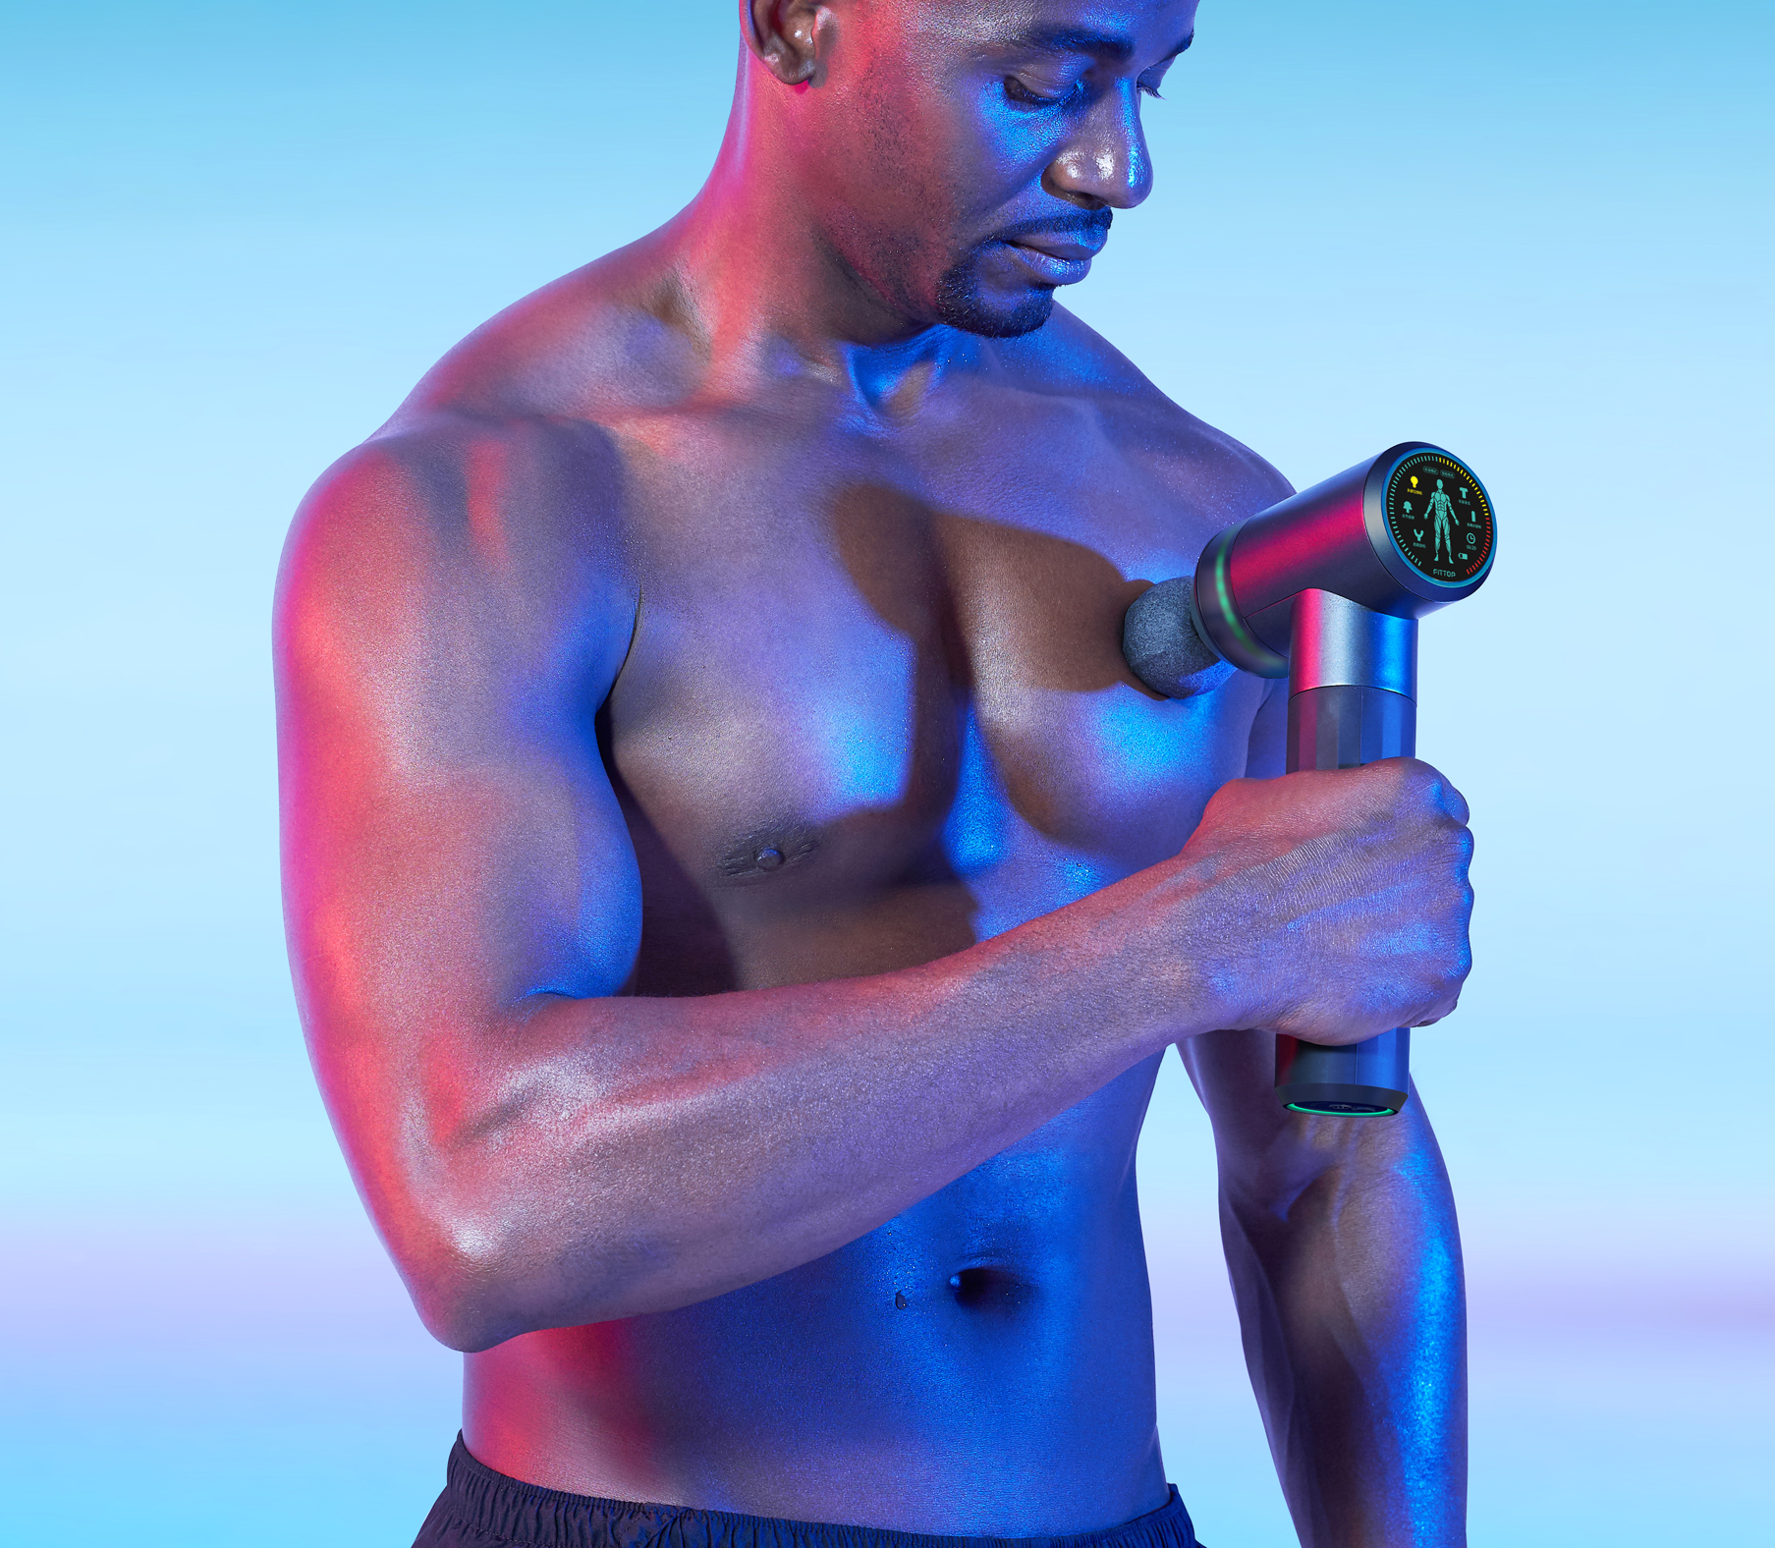

Slide 31
We aim to develop the most unique and competitive product to help your business growth!
THANK YOU

